Slide 1

Chapter 45 AVL Trees and Splay Trees

Slide 2
Objectives
To know what an AVL tree is (§45.1).
To understand how to rebalance a tree using the LL rotation, LR rotation, RR rotation, and RL rotation (§45.2).
To know how to design the AVLTree class (§45.3).
To insert elements into an AVL tree (§45.4).
To implement node rebalancing (§45.5).
To delete elements from an AVL tree (§45.6).
To implement the AVLTree class (§45.7).
To test the AVLTree class (§45.8).
To analyze the complexity of search, insert, and delete operations in AVL trees (§45.9).

Slide 3
Why AVL Tree?
The search, insertion, and deletion time for a binary tree is dependent on the height of the tree. In the worst case, the height is O(n). If a tree is perfectly balanced, i.e., a complete binary tree, its height is . Can we maintain a perfectly balanced tree? Yes. But it will be costly to do so. The compromise is to maintain a well-balanced tree, i.e., the heights of two subtrees for every node are about the same.

Slide 4
What is an AVL Tree?
AVL trees are well-balanced. AVL trees were invented by two Russian computer scientists G. M. Adelson-Velsky and E. M. Landis in 1962. In an AVL tree, the difference between the heights of two subtrees for every node is 0 or 1. It can be shown that the maximum height of an AVL tree is O(logn).

Slide 5
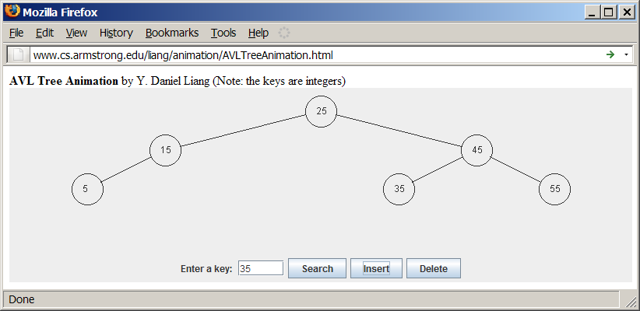
AVL Tree Animation
www.cs.armstrong.edu/liang/animation/AVLTreeAnimation.html

Slide 6
Balance Factor/Left-Heavy/Right-Heavy
The process for inserting or deleting an element in an AVL tree is the same as in a regular binary search tree. The difference is that you may have to rebalance the tree after an insertion or deletion operation. The balance factor of a node is the height of its right subtree minus the height of its left subtree. A node is said to be balanced if its balance factor is -1, 0, or 1. A node is said to be left-heavy if its balance factor is -1. A node is said to be right-heavy if its balance factor is +1.

Slide 7
Balancing Trees
If a node is not balanced after an insertion or deletion operation, you need to rebalance it. The process of rebalancing a node is called a rotation. There are four possible rotations.

Slide 8
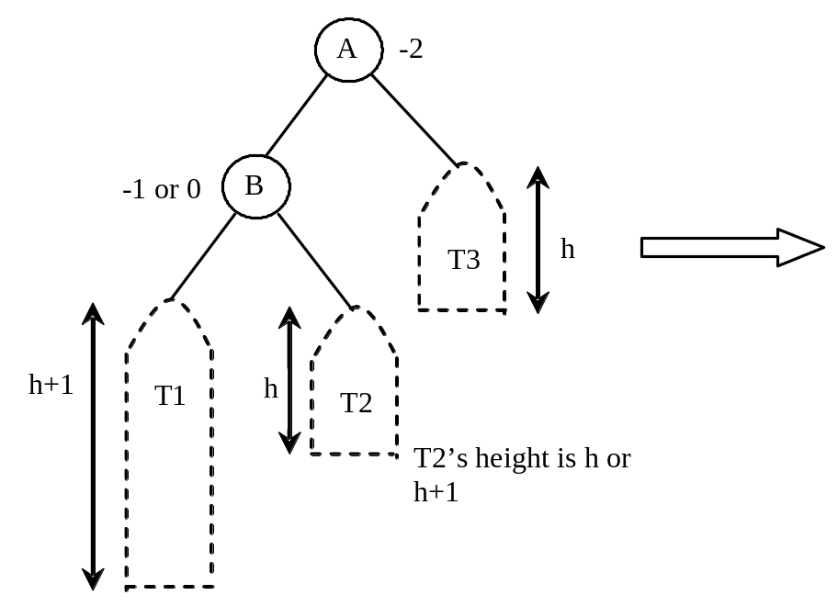
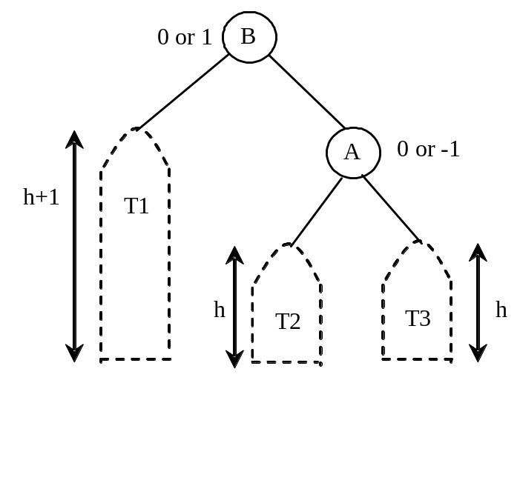
LL imbalance and LL rotation
LL Rotation: An LL imbalance occurs at a node A such that A has a balance factor -2 and a left child B with a balance factor -1 or 0. This type of imbalance can be fixed by performing a single right rotation at A.

Slide 9
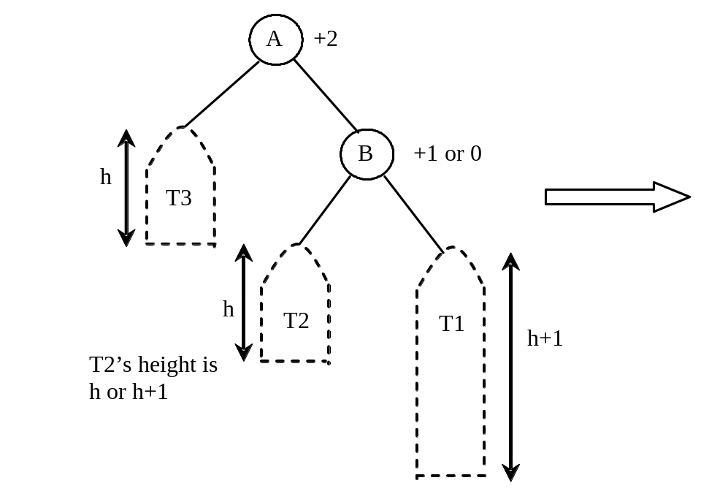
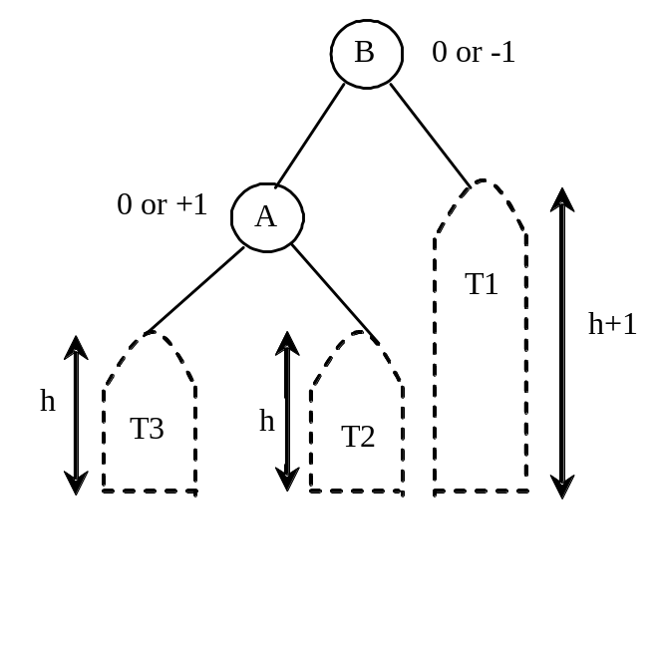
RR imbalance and RR rotation
RR Rotation: An RR imbalance occurs at a node A such that A has a balance factor +2 and a right child B with a balance factor +1 or 0. This type of imbalance can be fixed by performing a single left rotation at A.

Slide 10
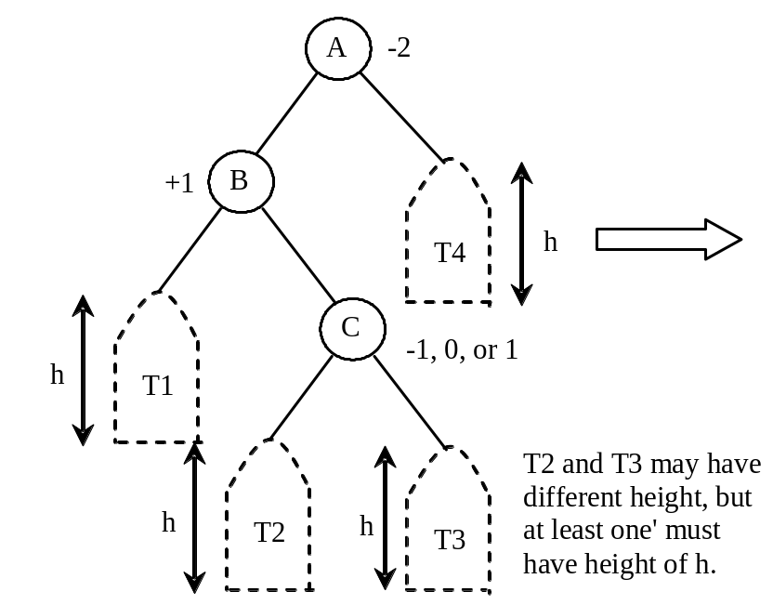
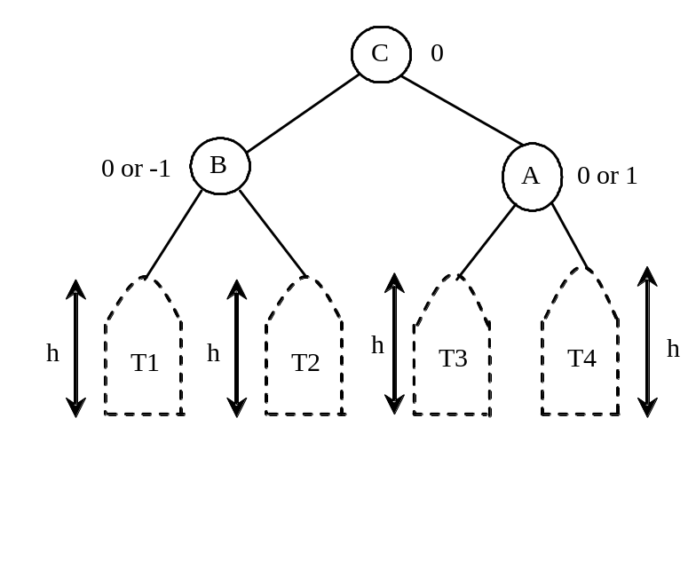
LR imbalance and LR rotation
LR Rotation: An LR imbalance occurs at a node A such that A has a balance factor -2 and a left child B with a balance factor +1. Assume B’s right child is C. This type of imbalance can be fixed by performing a double rotation at A (first a single left rotation at B and then a single right rotation at A).

Slide 11
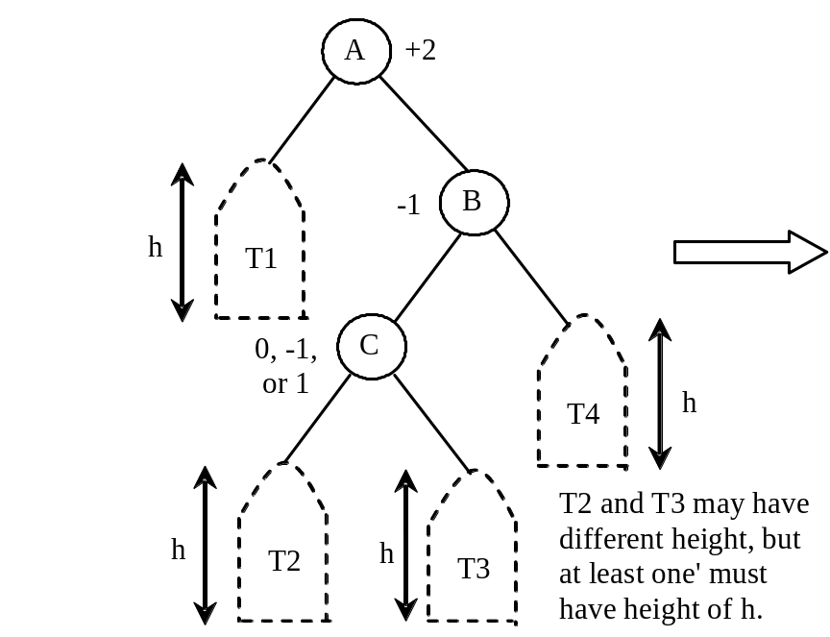

RL imbalance and RL rotation
RL Rotation: An RL imbalance occurs at a node A such that A has a balance factor +2 and a right child B with a balance factor -1. Assume B’s left child is C. This type of imbalance can be fixed by performing a double rotation at A (first a single right rotation at B and then a single left rotation at A).

Slide 12
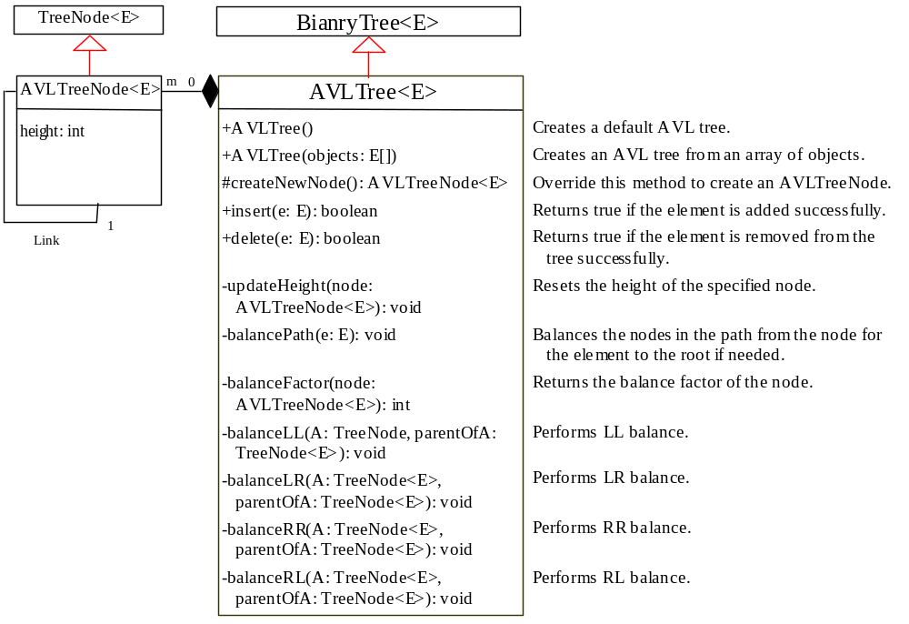
Designing Classes for AVL Trees
An AVL tree is a binary tree. So you can define the AVLTree class to extend the BinaryTree class.
AVLTree
TestAVLTree
Run

Slide 13
What is a Splay Tree?
If the elements you access in a BST are near the root, it would take just time to search for them. Can we design a BST that place the frequently-accessed elements near the root? Splay trees invented by Sleator and Tarjan are a special type of BST for just this purpose. A splay tree is a self-adjusting BST. When an element is accessed, it is moved to the root under the assumption that it will very likely be accessed again in the near future. If this turns out to be the case, subsequent accesses to the element will be very efficient.

Slide 14
AVL Tree vs. Splay Tree
An AVL tree applies the rotation operations to keep it balanced. A splay tree does not enforce the height explicitly. However, it uses the move-to-root operations, called splaying after every access, in order to keep the tree balanced. An AVL tree guarantees the height to be O(logn). A splay does not guarantee it. Interestingly, the splaying operations guarantees the average time for search, insertion, and deletion to be O(logn).

Slide 15
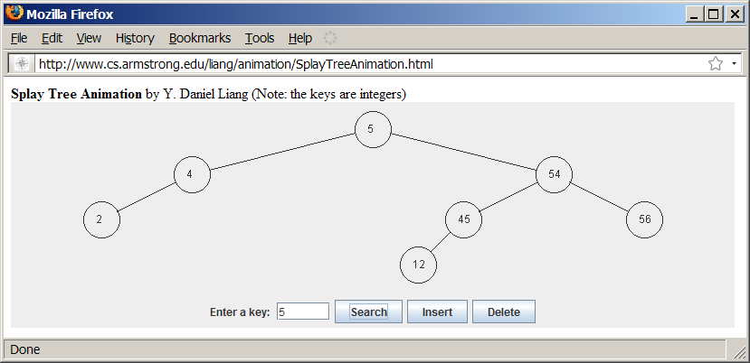
Splay Tree Animation
www.cs.armstrong.edu/liang/animation/SplayTreeAnimation.html

